Slide 1
Data Analysis - Feb 24
Full School
February attainment and Progress Oct-Feb

Slide 2
Glossary of terms
Attainment
Attainment is the total MAPP score or SS/OA Framework score for each outcome or objective at the Feb 24 assessment point.
Progress
Progress is the difference between the MAPP/Framework score at the Oct 23 assessment point and the Feb 24 assessment point.
MAPP
MAPP (Mapping and Assessing Personal Progress) is an assessment tool which has been developed to show small steps of progress and provides personalised comparative data over time for each individual. This allows us to compare data with the students own past progress. MAPP looks at four different areas Independence, Fluency, Maintenance and Generalisation and the areas are assessed from 1 to 10.
Small Steps
Small Steps is our bespoke Framework for English and Maths, this is used with our formal/Semi-formal learners from Y7 to Y10 where appropriate.
Open Awards
We use the Open Awards Frameworks for English and Maths with our formal/semi formal learners from Y10-Y14 where appropriate.
Outcomes
This refers to each students individual EHCP Outcomes.

Slide 3
Summary
AOP: Satellites progress Oct to Feb 24 above other provisions
AOP: MOZ progress slightly below other provisions for progress Oct to Feb 24
Whole School Progress - All AON similar in progress Oct 23 to Feb 24
PP students have made less progress this term
Attainment Feb 23 and Feb 24 similar. Oct 23 in comparison to Feb 24 attainment is significantly higher.
AON: Attainment Feb 24 scores are improved from Feb 23 but not as high as Oct 23.
AON: Attainment C&L has the greatest scores over 20 steps (others all similar)
AOP: MOZ has made the most attainment above scores of 20 and above
AOP Attainment: MLD/SLD and Enhanced have scored higher than Sat, PMLD/Complex and ASC whom area all similar with scores.

Slide 4
Summary
Overall (maths and English) Small Steps has made more progress this term than Open Awards by 13%. No concerns.
Open Awards
Very similar progress in OA Maths and English this term.
Small Steps
Identical progress in SS Maths and English progress
All SS English are similar for Feb 24 and are an improvement on Feb 23 and in line with Oct 23
Data has slightly less progress than other areas of maths but not significant.
There is a significant increase to Feb 23 and Feb 24 is in line with Oct 23.

Slide 5
Summary- AOP Attainment
In PMLD/ Complex needs, C&L had the least attainment and Sensory the most.These two areas were the highest last term so monitor next term.
In Enhanced, Sensory had the slowest attainment. C&L has made the greatest attainment this term. Last term was not of concern so monitor.
In MLD/SLD, sensory had the least attainment and C&L the greatest. This corresponds to last term. Intervention required.
In ASC, Ph&Med and Sensory had the least attainment. C&L the greatest. Last term was not of concern as all had 10 steps +
In MOZ C&L and PFA had significant attainment. SEMH had the least. Not of concern as last term SEMH had 10 steps +
In Satellites, C&L and C&I had the greatest attainment. Sensory and Ph&Med have made the least. This was not the case last term. Intervention req due to 0-4

Slide 6
Actions
Whole school progress decreased from this time last year and last term. Suspected problem- Brought data collection forward by two weeks. Ensure it is in line with previous years. Ensure future data collections have equal intervals.
Monitor PP students progress next term
In MLD/ SLD classes- provide interventions to help improve sensory outcomes progress. Identify through PP meets/ individual MAPP scores and provide staff information.
In Satellites investigate 0-4 attainment in Sensory and Physical & medical and provide intervention.

Slide 7
Progress
Oct 23 - Feb 24

Slide 8
Full School Progress Feb 24
Progress Oct 23 to Feb 24
There is less progress from last term and February 23
*Suspected issue submission date brought forward to January rather than February.
16%
12%
12%
16%
23%
60%
Notes:
.

Slide 9
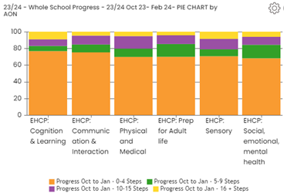
Full School Progress Oct 23 - Feb 24 - by Area of Need
All areas very similar in progress from Oct-Feb in AON
C&L 77, 6, 8, 9
C&I 75, 10, 11, 4
Ph&Med 70, 10, 15, 5
PFA 70, 15, 11, 4
Sensory 71, 8, 13, 8
SEMH 69, 16, 9, 6

Slide 10
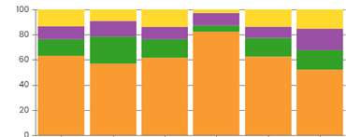
Full School Progress - Oct - Feb 24 by AOP
Satellites have made the most progress and MOZ has made the least progress in Feb.
All fairly similar.
PMLD/CN
ASC
Enhanced
MOZ
MLD/SLD
Satelites
PMLD 63, 13, 11, 13
ASC 57, 22, 12, 9
ENH 62, 15, 10, 13
MOZ 82, 5, 10, 3
MLD/SLD 63, 15, 9, 13
SAT 52, 16, 17, 15
Decrease in progress from last term/ Feb 23

Slide 11
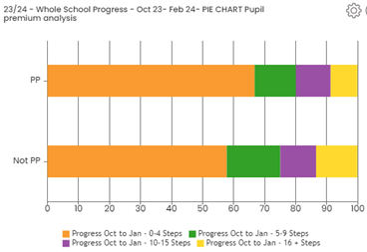
Full School Progress Oct 23 to Feb 24 - PP V Non PP
Our PP and Non PP students have made similar progress in February but PP have made slightly less progress this term.
Non PP students have a score of 42 for above 5 steps of progress.
PP have a score of 33
PP 67, 13, 11, 9
Not PP 58, 17, 12, 13

Slide 12
Attainment
Feb 24

Slide 13
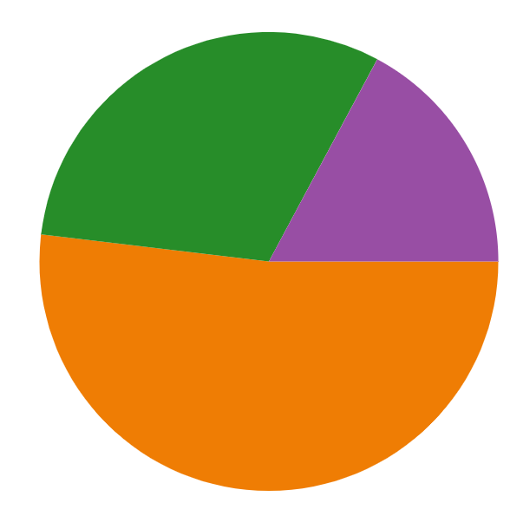
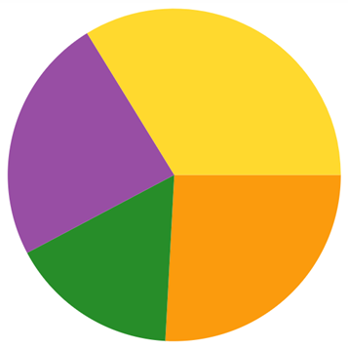
Full School Attainment
Attainment Feb 23
(Total MAPP scores of EHCP Outcomes)
Attainment in Oct 23
Attainment in Feb 24
30%
34%
31%
16%
17%
24%
26%
55%
52%
16%
In Feb 23 and Feb 24 have similar attainment scores. Oct 23 was significantly higher.

Slide 14
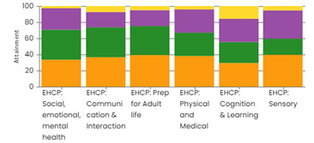
Full School Attainment Feb 24 - Total MAPP scores for EHCP Outcomes by AON
Feb 24 scores are improved from Feb 23 but not as high as Oct 23.
C&L has the greatest scores over 20 steps
All other areas are similar in scores.
SEMH 34, 37, 27, 2
C&I 37, 37, 19, 7
PFA 39, 36, 20, 5
Phy & med 38, 29, 29, 4
C&L 30, 26, 29, 15
Sensory 40, 20, 35, 5

Slide 15
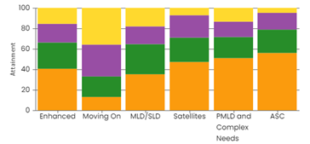
Full School Attainment Feb 24 - MAPP Total scores for EHCP Outcomes by AOP
Enh 41, 26, 18, 15
MOZ 13, 20, 31, 36
MLD/SLD 36, 29, 17, 18
Sat 47, 24, 22, 7
PMLD/ Complex 51, 21, 15, 13
ASC 56, 23, 16, 5
MOZ has made the most attainment above scores of 20 and above
MLD/SLD and Enhanced have scored higher than Sat, PMLD/Complex and ASC whom area all similar with scores.

Slide 16
Small Step and Open Awards
Progress Oct-Feb

Slide 17
Small Steps and Open Awards Progress - Oct 23 - Feb 24
Overall (maths and English) Small Steps has made more progress this term than Open Awards by 13%. No concerns.
Open Awards
Small Steps
87%
74%
13%
26%

Slide 18
Open Awards Progress - English and Maths from Oct 23 - Feb 24
Maths
English
Very similar progress in OA Maths and English this term.
70%
72%
30%
28%
Notes:
No actions required.

Slide 19
Small Steps Progress - English and Maths - Oct 23 - Feb 24
Maths
English
Identical progress in SS Maths and English progress
87%
87%
13%
13%

Slide 20
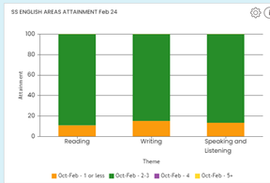
Small Steps - Attainment in English Areas - Oct 23 - Feb 24
Reading 11, 89
Writing 15, 86
Speaking and Listening 13, 87
All SS English are similar for Feb 24 and are an improvement on Feb 23 and in line with Oct 23

Slide 21
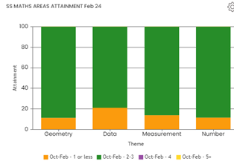
Small Steps - Progress in Maths Areas - Oct 22 - Feb 23
Geometry 11, 89
Data 21, 79
Measurement 14, 86
Number 12, 88
Data has slightly less progress than other areas of maths but not significant.
There is a significant increase to Feb 23 and Feb 24 is in line with Oct 23.

Slide 22
Areas of Provision
Attainment Feb

Slide 23
PMLD and Complex Needs - Attainment in AON Feb 24
SEMH 54, 19, 12, 15
C&I 52, 16, 6, 26
PFA 52, 16, 16, 16
Ph&Med 18, 23, 41, 18
C&L 50, 19, 31, 0
Sensory 0, 33, 33, 34
In PMLD/ Complex needs, C&L has made the slowest progress and Sensory the most progress. These two areas were the highest last term so monitor next term.

Slide 24
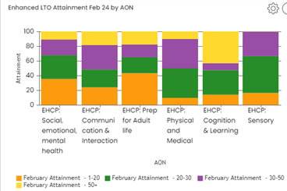
Enhanced - Attainment in AON - Feb 24
SEMH 36, 32, 21, 11
C&I 24, 24, 33, 19
PFA 43, 21, 33, 19
Ph&Med 10, 40, 40, 10
C&L 14, 33, 10, 43
Sensory 17, 50, 33, 0
In Enhanced Sensory has made the slowest progress. C&L has made the greatest progress this term. Last term was not of concern so monitor.

Slide 25
MLD/SLD - Attainment in AON - Feb 24
SEMH 26, 48, 22, 4
C&I 12, 52, 20, 16
PFA 27, 38, 23, 12
Ph&Med 27, 40, 20, 13
C&L 13, 13, 33, 41
Sensory 43, 43, 14, 0
In MLD/SLD sensory has made the least progress and C&L the greatest. This corresponds to last term. Intervention required.

Slide 26
ASC - Attainment in AON - Feb 24
SEMH 55, 24, 15, 6
C&I 49, 20, 26, 5
PFA 36, 28, 32, 4
Ph&Med 25, 58, 17, 0
C&L 35, 26, 26, 13
Sensory 33, 56, 11, 0
In ASC, Ph&Med and Sensory has made the least progress. C&L the greatest progress. Last term was not of concern as all had 10 steps +

Slide 27
MOZ - Attainment in AON -Feb 24
SEMH 30, 40, 30, 0
C&I 10, 30, 40, 20
PFA 10, 10, 80
Ph&Med 0, 0, 100, 0
C&L 0, 0, 38, 62
Sensory 0, 0, 100, 0
In MOZ C&L and PFA have made significant progress. SEMH has made the least progress.
Not of concern as last term SEMH had 10 steps +

Slide 28
Satellites -Attainment in AON - Feb 24
SEMH 58, 25, 16, 0
C&I 44, 36, 16, 4
PFA 54, 42, 0, 4
Ph&Med 100, 0, 0, 0
C&L 8, 17, 50, 25
Sensory 100, 0, 0, 0
In Satellites, C&L and C&I have made the greatest progress. Sensory and Ph&Med have made the least progress. This was not the case last term. Intervention req due to 0-4

